Slide 1

Avocado Trends 2017-2019
By: Erica, Arianne, & Bitty

Slide 2
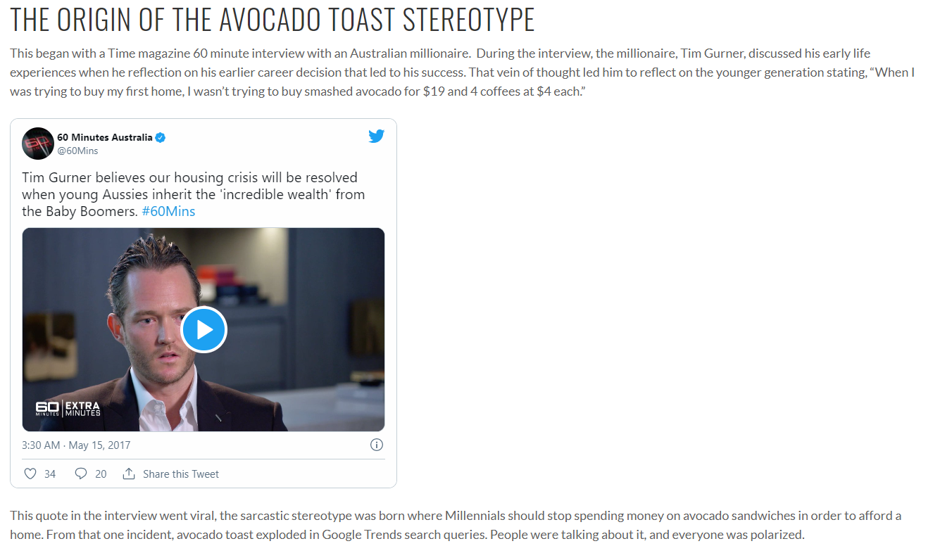
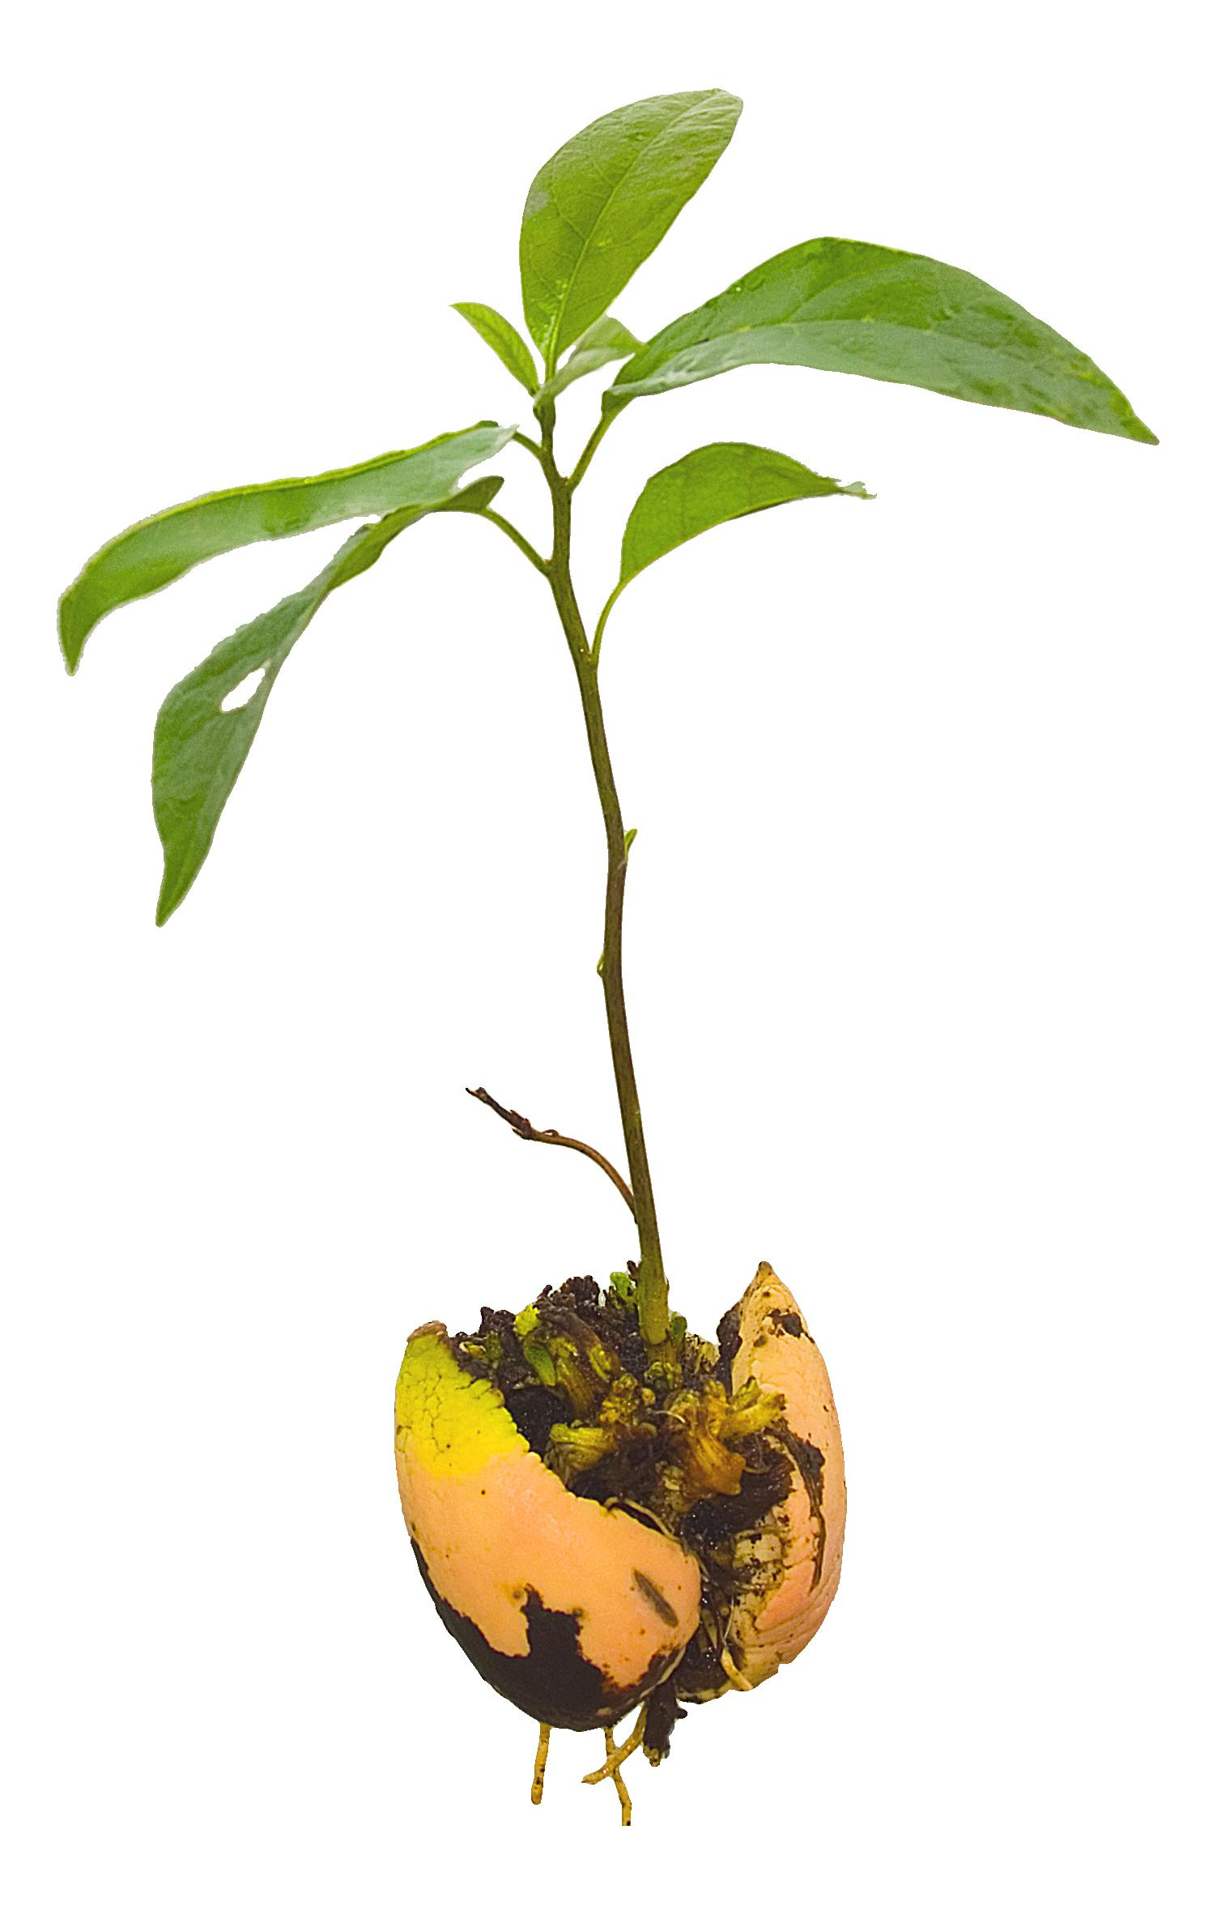
Mission:
Use avocado purchasing data to infer popularity and profitability by avocado type and purchase location.
Determine the relationship between wealth and avocado popularity.
Mark Hofstetter (2006)
https://jeffjbutler.com/2019/04/12/where-did-the-avocado-toast-millennial-stereotype-come-from/

Slide 3
Our initial questions
Question 1:
Question 2:
Question 3:
Which cities love avocados most?
Do states with higher income per capita buy more avocados? (income per capita from 2017-2019)
Which type of avocado is the biggest source of revenue for suppliers?

Slide 4
Our initial questions
Question 4:
Question 5:
Question 6:
Is there a time of year that sees a spike in revenue?
How has the average avocado price changed over time? What is the predicted avocado price for 2021 based on our data?
Do different types of avocados have different price trends?

Slide 5



Data Sources:
https://www.kaggle.com/timmate/avocado-prices-2020
https://www.kaggle.com/max-mind/world-cities-database
https://www.bea.gov/data/income-saving/personal-income-county-metro-and-other-areas

Slide 6

Data Cleansing & Challenges
Excel clean up prior to reading into jupyter notebook
Merging different CSV Files into 1 cohesive Dataframe
GitHub merge nightmare
Finding all the discrepancies in the Data to resolve
Combining all work into one jupyter notebook

Slide 7

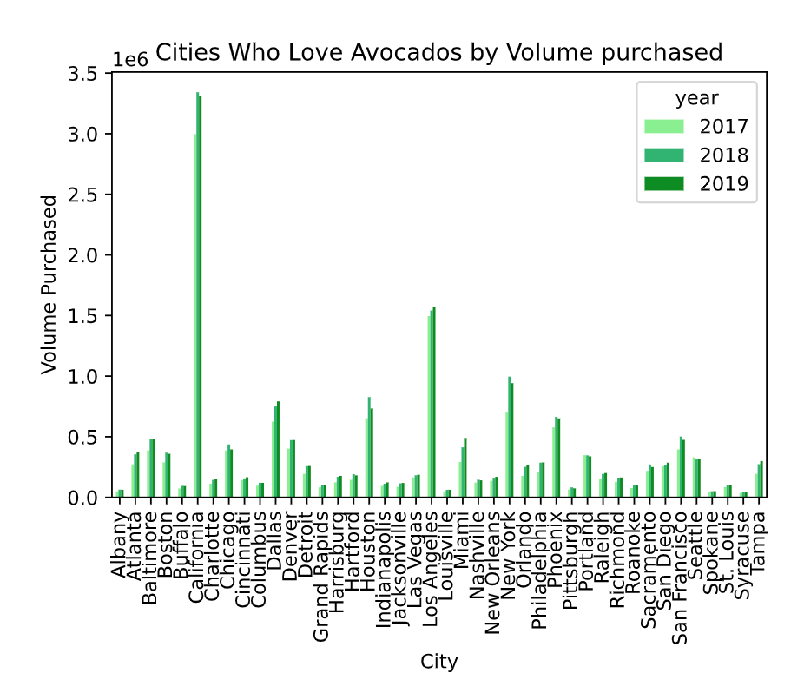
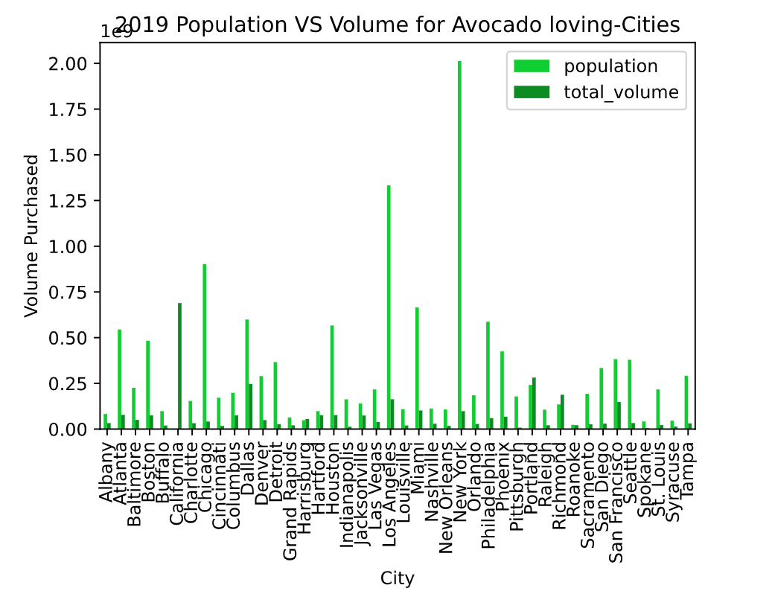
Which cities love avocados most?
#Side by side comparison
ax = essential_2019.groupby(['city']).sum().plot(color='forestgreen')
essential_population.groupby(['city']).sum().plot(color='limegreen', ax=ax)
plt.xlabel("City")
plt.xticks(np.arange(len(unique)), unique, rotation=90)
plt.ylabel("Volume")
plt.title("Population Comparison VS Volume of Avocados Sold")
plt.savefig("Output/2019_comparison.png")
plt.show()
Task 1: Popularity by Volume, Population comparison

Slide 8
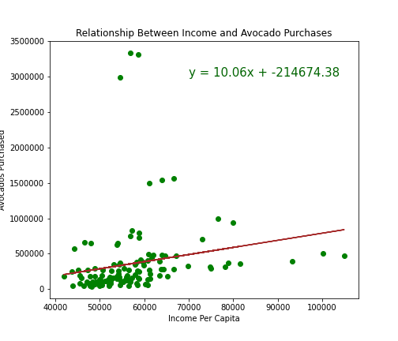
Do states with higher income per capita buy more avocados?
Task 2:
Scatter plot (x-values: income per capita per year for each city, y-values: average avocados purchased per year for each city)
Answer:
On average, one more dollar in income per capita results in ten more avocados smashed on toast. However, the correlation is not very strong.
The correlation between both factors is 0.2

Slide 9

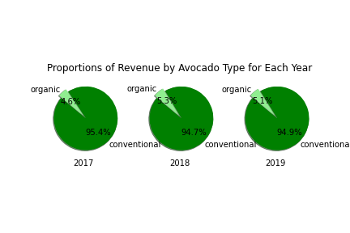
Which type of avocado is the biggest source of revenue for suppliers?
Task 3:
Three pie charts by type (value = revenue) for each year on one png
Answer:
By far, conventional avocados are the biggest source of revenue for suppliers. The pattern is consistent over the three years we tested.
figure, (ax1, ax2, ax3) = plt.subplots(1,3,subplot_kw={'aspect':'equal'})

Slide 10
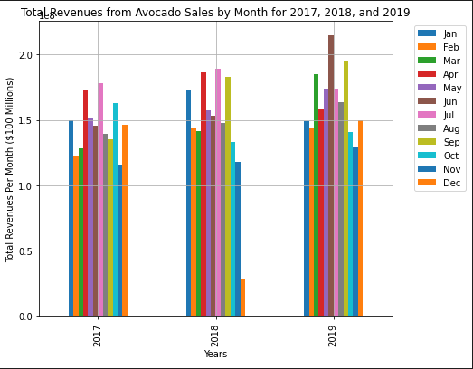
Is there a time of year where we see a spike in avocado revenue?
Task 4:
Bar chart (x-values: months (seperated by year), y-values: total avocado revenues)
Answer:
Yes, a general shape emerges that shows the summer months see a higher level of sales than the rest.
Highest revenue month:
2017: July
2018: July
2019: June
income_avocado_pivot = pd.pivot_table(income_avocado, values='revenue', index='year', columns='month', aggfunc=np.sum)

Slide 11

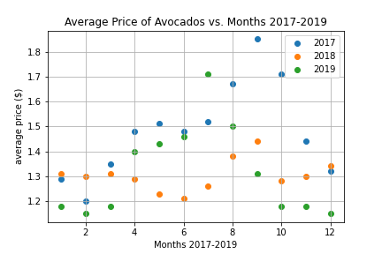
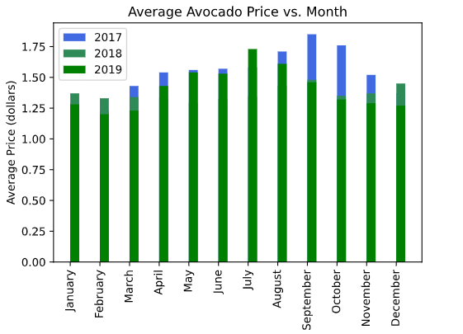
How has the average avocado price changed over time?
Task 5: scatter plot with regression to predict 2021 average price

Slide 12
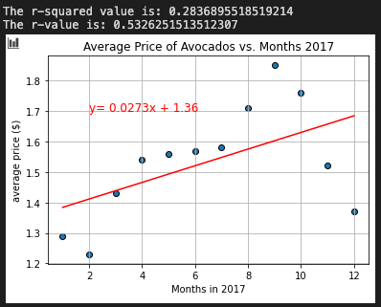
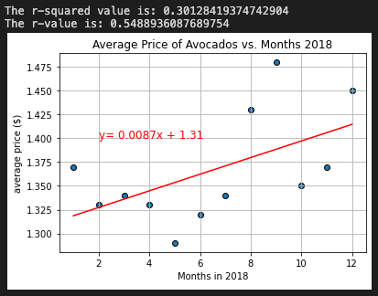
How has the average avocado price changed over time? R Values for 2017 and 2018.
Task 5: scatter plot with regression to predict 2021 average price

Slide 13
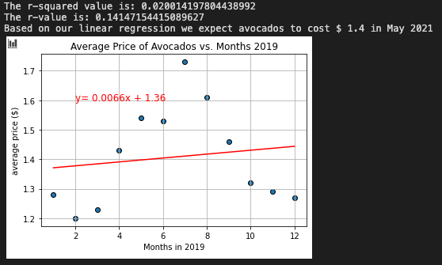

How has the average avocado price changed over time? What is the predicted avocado price for 2021 based on our data?
Task 5: scatter plot with regression to predict 2021 average price

Slide 14
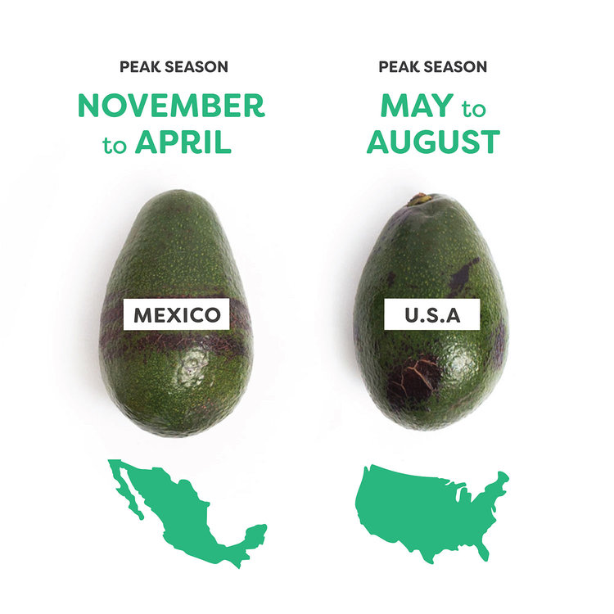
Possible Explanations for Price Variation
Produce that isn’t locally/nationally in-season has to be imported from other countries that have that produce available.
The importing costs could help to explain the price changes throughout the year, as well as demand, and drought.
http://blog.imperfectfoods.com/blog-1/2019/2/13/when-are-avocados-in-season

Slide 15
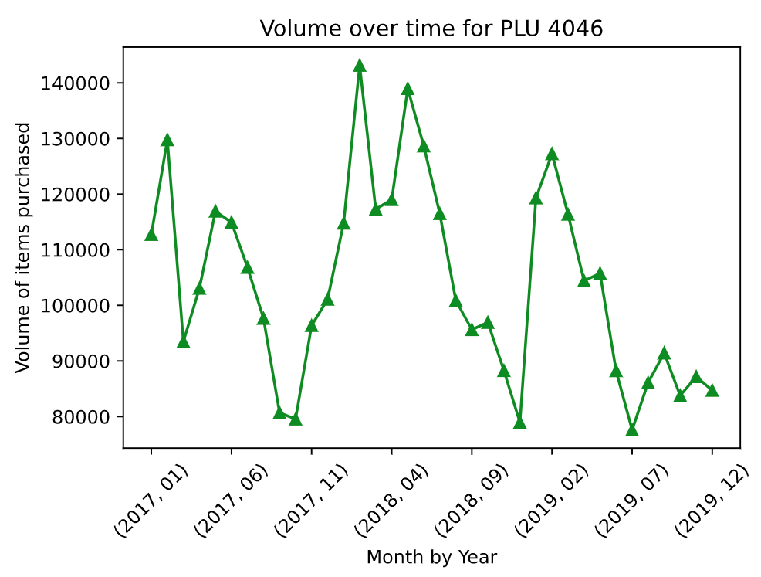
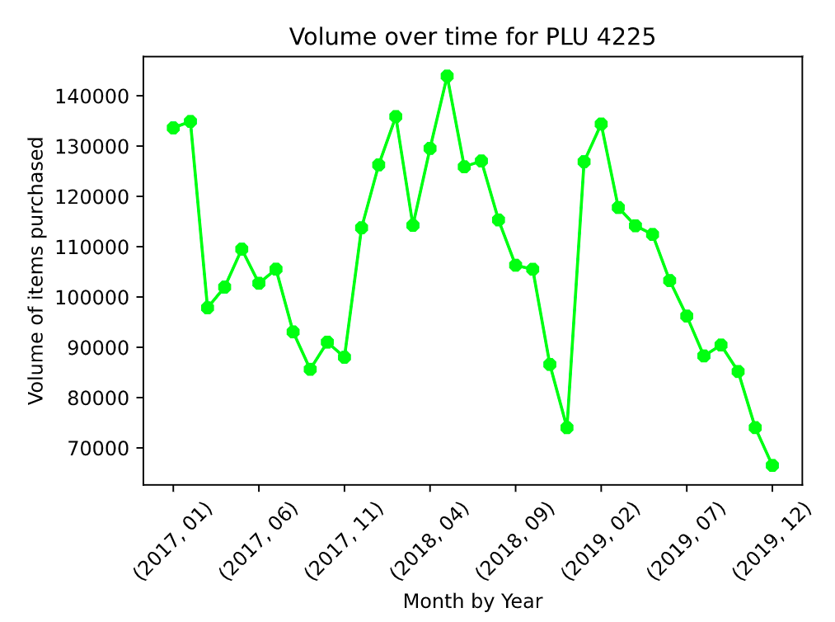
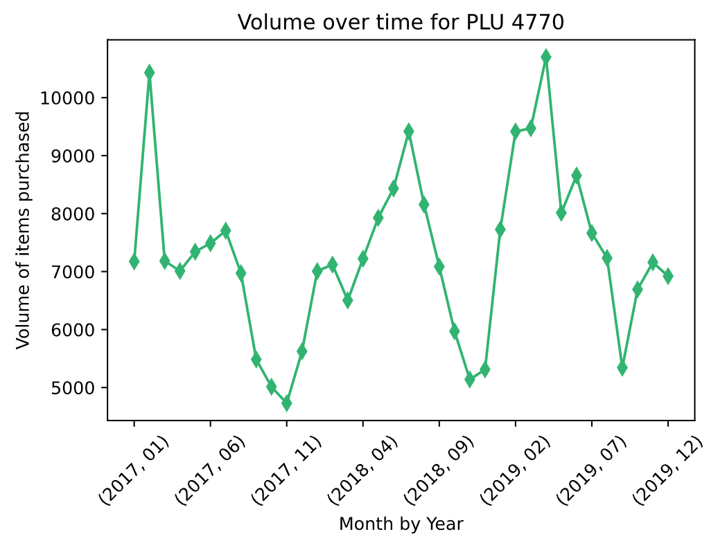
Do different types of avocados have different price trends?
Task 6: facet (multiple lines on one) line graph (x-values = year, y-values = average price) for each type
4046: Small size Avocado 4225: Large Size Avocado 4770: Extra Large Size Avocado

Slide 16

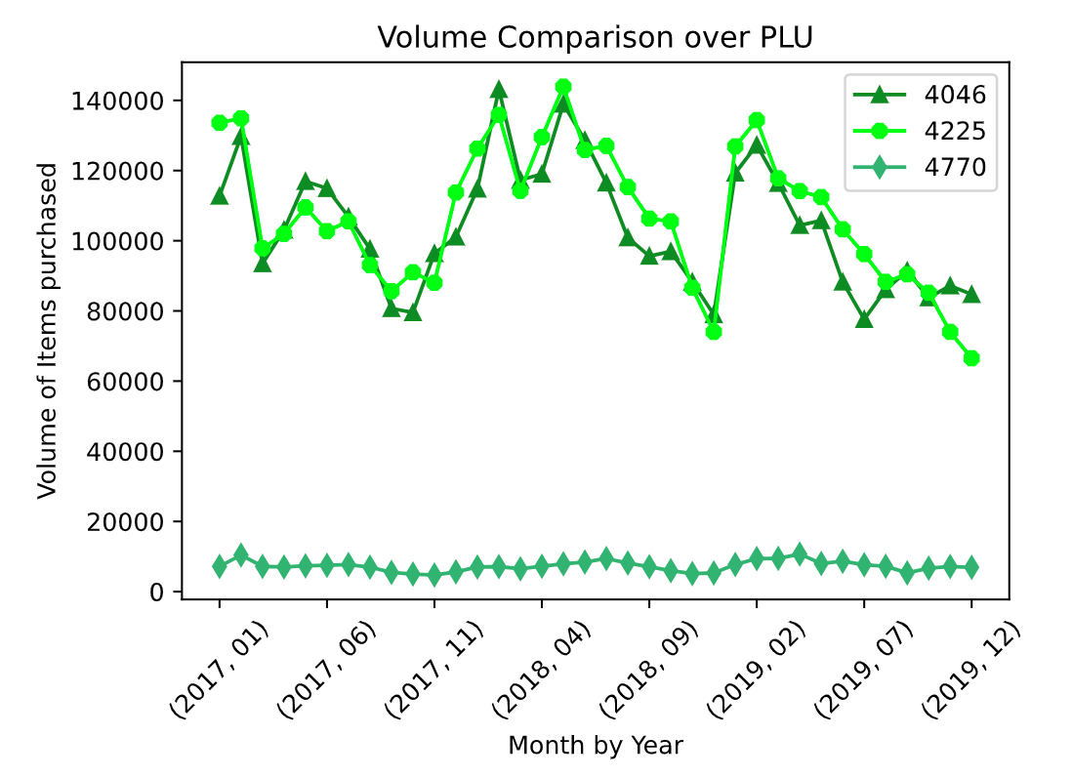
Facet Chart Comparison of all 3 PLUs

Slide 17

The End
Questions?

